Slide 1
SWE 4701
Software Metrics and Process
Lec - 3

Slide 2
Empirical Investigation
What is software engineering investigation?
  Applying "scientific" principles and techniques to investigate properties of software and software related tools and techniques.
Why talking about software engineering investigation?
  Because the standard of empirical software engineering research is quite poor.
"the scientific method is merely a formalization of learning by experience"
Cooking
  You add extra salt
  Food tastes bad
  Next time, you add less salt
That’s experience-based learning.
Scientific method:
  Measure salt
  Test recipes
  Record taste results
  Optimize
Same learning, but formalized.

Slide 3
Empirical Investigation
An empirical investigation is a study where conclusions are drawn based on real-world observation, data, or experiments, not just theory or assumptions.
In short, learning from actual evidence.
If you want to know:
“Do students study more before exams?”
If you want to know:
“Code reviews reduce bugs” (assumption)
For this You:
  Observe their study hours
  Collect data from students
  Analyze results
For this You:
  Collect data from projects with code reviews
  Compare defect counts with projects without reviews
  Analyze the results
That is an empirical investigation
That is an empirical investigation

Slide 4
Empirical Investigation - Why
To improve (process and/or product)
To evaluate (process and/or product)
To prove a theory or hypothesis
To disprove a theory or hypothesis
To understand (a scenario, a situation)
To compare (entities, properties, etc.)
→For better processes, tools, and languages to gather and analyze requirements, model designs, develop, test, and evolve applications..

Slide 5
Empirical Investigation - What
Developer’s performance
Tool's performance
Person's perceptions
Tool's usability
Document's understandability
Program's complexity etc.

Slide 6
Empirical Investigation - How
Hypothesis/question generation
Data collection
Data evaluation
Data interpretation
Feed back into the iterative process

Slide 7
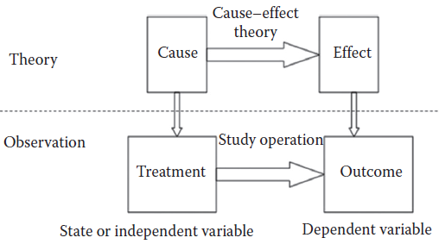
Empirical Study
An empirical study examines some specific sample or observation of all of the possible values of the variables involved in a cause-and-effect relationship.
Empirical studies are conducted to test the theory.
Empirical studies do not prove that a theory is true. Rather, they provide further evidence to support or disprove the theory.
An empirical study examines some specific sample or observation of all of the possible values of the variables involved in a cause–effect relationship

Slide 8
Empirical Study - Examples
Experiment to confirm rules-of-thumb
  Should the LOC in a module be less than 200?
Experiment to explore relationships
  How does the project team experience with the application affect the quality of the code?
  How does the requirements quality affect the productivity of the designer?
  How does the design structure affect maintainability of the code?
Experiment to initiate novel practices
  Would it be better to start OO design with UML?
  Would the use of SRE improve software quality?

Slide 9
Empirical Study
The key principles involved in designing empirical studies include
1. Selecting investigation technique
2. Stating Goal & hypothesis
3. Maintaining control over variables
4. Threats to validity
5. Human subjects
conducting surveys, case studies, formal experiments
What should be investigated?
dependent and independent variables
No study is perfect; there are many ways that a study can provide misleading results.
government and university regulations require that research involving human subjects meet specified standards.

Slide 10
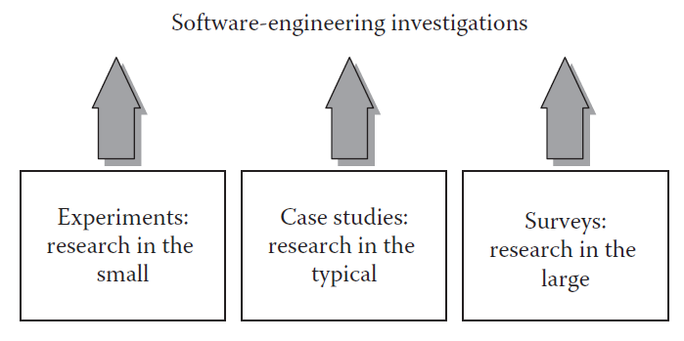
Selecting investigation technique
Software engineering research is categorized by the scale and nature of the study.
Experiments: "Research in the Small"
  Rigorous, high-control studies often done in labs or academia.
Case Studies: "Research in the Typical"
  Observation of a tool or technique on a typical project without full control.
Surveys: "Research in the Large"
  Retrospective polling of large groups to identify broad trends and relationships.

Slide 11
Selecting investigation technique
Type | Scale | Control Level | Validity Strength | Main Goal
Experiment | Small | High | Internal validity | Test cause-effect
Case Study | Medium | Moderate | Real-world insight | Evaluate in practice
Survey | Large | Low | External validity | Identify trends

Slide 12
Controlled Experiments vs. Reality
Use Controlled Experiments to test hypotheses by manipulating independent variables and measuring effects on dependent variables.
Scientific Constraints: Like astrophysicists with black holes, we often cannot control all variables (e.g., developer skill, environment).
Ethical/Legal Barriers: Random assignment is often impossible or unethical in human-centric studies.
A quasi-experiment is a study that tries to examine cause–effect relationships but does NOT use random assignment and does not fully control all variables.
Most "case studies" in software engineering are actually quasi-experiments because they lack random assignment or full variable control

Slide 13
Surveys & Case Studies
Surveys (Retrospective)
  Timing: Conducted after an event has occurred.
  Goal: Document relationships and how a population reacted to a method or tool.
  Example: Analyzing code size and faults after a project completes its first "Agile" cycle.
Case Studies (Prospective or Retrospective)
  Focus: Identifying key factors (inputs, constraints, resources) in a real-world setting.
  Use Case: Preferred when process changes are wide-ranging and hard to isolate.

Slide 14
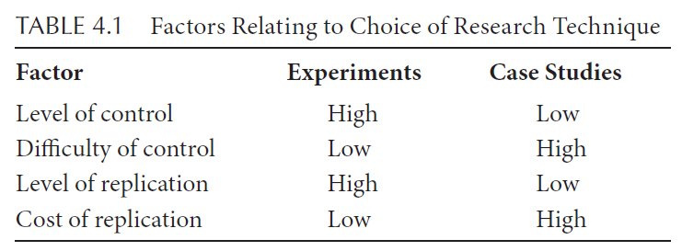
Choosing Your Technique
The choice depends on your level of control and the ability to replicate the study.
When to use Experiments: Best for self-standing, isolated tasks (e.g., comparing requirement specification languages like JML vs. OCL).
When to use Case Studies: Best for safety-critical systems or when the cost/risk of manipulating variables is too high.

Slide 15
Stating Goal & hypothesis
The foundation of any empirical study is a clear understanding of what you want to investigate.
  The Purpose of a Goal: Your goal dictates the choice of research technique (Survey, Case Study, or Experiment).
  The Hypothesis: A tentative idea that explains the behavior you want to explore.
  Testing the Idea: Whether you are polling developers (Survey), observing an organization (Case Study), or running a lab test (Experiment), you are gathering data to confirm or reject your hypothesis.
Example: "Using Scrum produces better quality software than using Extreme Programming (XP)."

Slide 16
Making Hypotheses Testable
Research hypotheses must be measurable
Vague concepts cannot be empirically tested
Quantification makes hypotheses testable
Hypothesis: Using Scrum produces better quality software than using Extreme Programming (XP).
Is it Testable??????
Problem:
  Better quality is not defined
  No measurable criteria
  Cannot collect empirical evidence

Slide 17
Making Hypotheses Testable
Define quality in measurable terms.
Revised Hypothesis: If Scrum produces better quality software than XP, then Scrum code will have fewer defects per thousand lines of code (KLOC) than XP code.
Is it Testable??????
Yes:
  Quality → Measured using defects/KLOC
  Clear comparison possible
Role of Quantification
  Defines measurable variables
  Enables data collection
  Supports statistical testing
  Allows predictions
Example Measure:
  Defects per thousand lines of code

Slide 18
Surrogate Measures
A surrogate measure is an indirect metric used to represent something that cannot be measured directly.
In other words, it is a substitute metric used to approximate a concept that is difficult or impossible to measure directly.
Example : Software Quality
is abstract. It includes:
    Reliability
    Maintainability
    Performance
    Usability
    Security
    Correctness
We cannot directly measure “quality” as a single number.
The surrogate measure:
Defects per thousand lines of code (Defects/KLOC)
Why?
Because fewer defects usually suggest higher quality.

Slide 19
Surrogate Measures
The Problem
Defects are only a proxy for quality.
Scenario A:
  Many defects found during testing
  → Could mean poor development
  → OR very thorough testing
Scenario B:
  Few defects found
  → Could mean high quality
  → OR poor testing
So defects ≠ perfect representation of quality.
This is the danger of surrogate measures.
The Problem
Number of delivered lines of code is a surrogate measure of development effort.
But:
  100 lines of simple CRUD code ≠ 100 lines of complex algorithm
  Different difficulty levels
  So LOC ≠ actual effort.

Slide 20
Scientific Skepticism
A hypothesis is NOT true unless strong evidence supports it.
In research, skepticism means:
  Do not assume your hypothesis is correct.
  Assume it is false until data strongly supports it.
  Require statistical evidence before making conclusions.
Approach:
  Formulate a Null Hypothesis
  Attempt to reject it statistically
Null Hypothesis (H₀)
H₀: There is no difference in quality between Scrum and XP (measured by defects/KLOC).
Goal:
Reject H₀ using strong statistical evidence.
Reject only if the probability of no difference is less than 5% (p < 0.05)
Alternative Hypotheses- If H₀ is rejected, evaluate alternatives:
Hₐ₁: Scrum produces fewer defects per KLOC than XP
Hₐ₂: XP produces fewer defects per KLOC than Scrum
Only after rejecting H₀ can we support one of these.

Slide 21
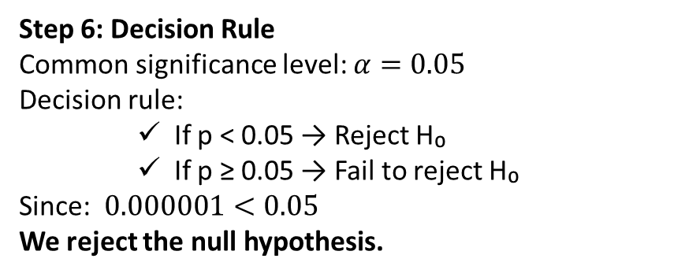
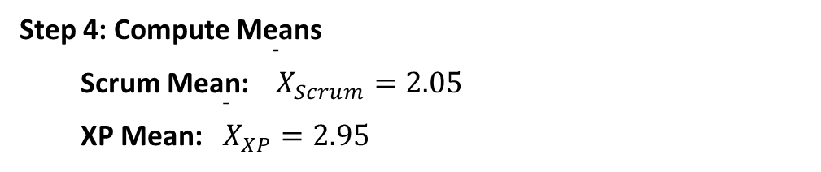
Hypothesis Testing (Example)
Step 1: Research Question
Does Scrum produce better quality software than XP? (Defects/KLOC)
Step 2: Define Hypotheses
Null Hypothesis (H₀)
There is no difference in mean defects/KLOC between Scrum and XP. $H_{0}:μ_{Scrum}=μ_{XP}$
Alternative Hypothesis (H₁)
Scrum produces fewer defects than XP. $H_{1}:μ_{Scrum}<μ_{XP}$
Step 3: Collect Data
Step 6: Decision Rule
Common significance level: $α=0.05$
Decision rule:
    If p < 0.05 → Reject H₀
    If p ≥ 0.05 → Fail to reject H₀
Since: $0.000001<0.05$
We reject the null hypothesis.
Scrum (Defects/KLOC): 2.1, 1.9, 2.3, 2.0, 2.2, 1.8, 2.1, 2.0
XP (Defects/KLOC): 2.8, 3.0, 2.9, 3.2, 2.7, 3.1, 2.9, 3.0
Step 4: Compute Means
  Scrum Mean: ${\overset{ˉ}{ X}}_{Scrum}=2.05$
  XP Mean: ${\overset{ˉ}{ X}}_{XP}=2.95$
Step 5: Perform t-Test
Assume we perform an independent samples t-test.
Suppose we get: t = -8.5 and p-value = 0.000001
Step 7: Conclusion
There is strong statistical evidence that Scrum produces fewer defects per KLOC than XP.

Slide 22
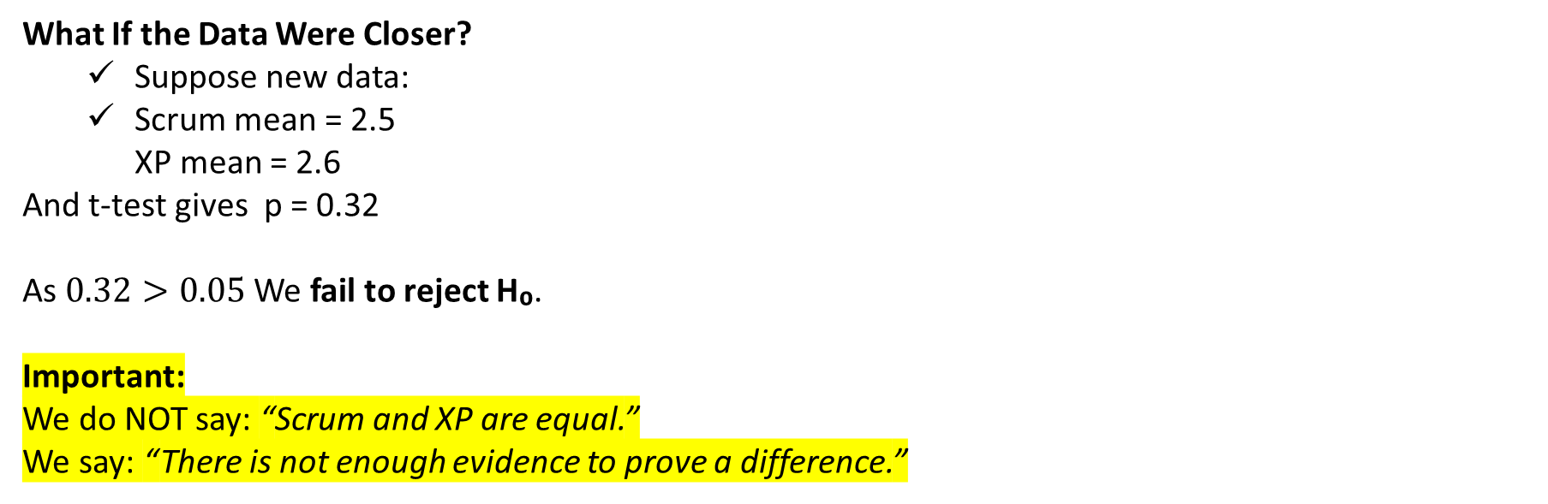
Hypothesis Testing (Example)
What If the Data Were Closer?
  Suppose new data:
  Scrum mean = 2.5
  XP mean = 2.6
And t-test gives p = 0.32
As $0.32>0.05$ We fail to reject H₀.
Important:
We do NOT say: “Scrum and XP are equal.”
We say: “There is not enough evidence to prove a difference.”

Slide 23
Type I and Type II Errors
Type I Error:
Reject H₀ when it is actually true. (False positive)
Type II Error:
Fail to reject H₀ when it is false. (False negative)
Example Type I : Scrum vs XP Defects
  H₀: Scrum and XP produce software of the same quality (same defects/KLOC).
  H₁: Scrum produces fewer defects than XP.
Suppose in reality, Scrum and XP actually produce the same quality, but your statistical test gives p < 0.05.
We reject H₀ and conclude Scrum is better.
Error: You claimed Scrum is better when it’s not. This is a Type I error.
Example Type II : Scrum vs XP Defects
Scenario:
  True situation: Scrum actually produces fewer defects than XP.
  Your statistical test gives p > 0.05, so you fail to reject H₀.
So we concluded there’s no difference, even though Scrum is indeed better.
This is a Type II error.

Slide 24
Quiz#1 [write full Student ID & Course Code]
A software engineering team wants to investigate whether using Test-Driven Development (TDD) affects sprint velocity compared to traditional development. Sprint velocity is measured as Story Points completed per sprint. The following data were collected from 8 sprints for each method:
TDD (Story Points/Sprint):
28, 32, 30, 31, 29, 33, 30, 32
Traditional Development (Story Points/Sprint):
25, 27, 26, 24, 28, 26, 27, 25
An independent samples t-test gives the results: t = 3.5, p-value = 0.003
Answer the following:
(a) Formulate the Null and Alternative Hypotheses using proper statistical notation. (3 marks)
(b) Why is “sprint velocity” not a perfect measure of productivity? (3)
(c) State the decision rule at α = 0.05 and make a statistical decision. (3)
(d) What conclusion can the researcher draw? (2)
(e) Explain what would be a Type I error and a Type II error in this context. (4)

Slide 25
Quiz Solution
(a) Null Hypothesis: H₀: μTDD = μTraditional
Alternative Hypothesis: H₁: μTDD > μTraditional
(b) Velocity is a surrogate for productivity; complexity and quality differences may affect interpretation.
(c) Reject H₀ if p < 0.05 and Here, 0.003 < 0.05 so we Reject H₀
(d) TDD sprints have higher velocity, likely more productive in terms of story points completed.
(e) Type I: Concluding TDD improves velocity when it does not.
Type II: Concluding no difference when TDD actually improves velocity.

Slide 26
Maintaining Control over Variables
After defining a hypothesis, identify variables that affect it.
Decide how much control you have over each variable.
Experiments: High control, can manipulate variables.
Case studies: Low control, observe naturally occurring behavior.
Example:
  Hypothesis: “Scrum improves software quality compared to XP.”
  Experiment: Assign teams to Scrum or XP.
  Case study: Observe existing projects using Scrum or XP without control.
Independent and Dependent Variables
State / Independent Variable: Factor you can manipulate to observe effects.
Dependent Variable: Outcome affected by independent variables.
Example:
  Investigating the effect of programming language on code quality:
    State variable: Programming language (C, Java, Python)
    Dependent variable: Defects per KLOC

Slide 27
Control vs Treatment
When we want to test whether something causes an improvement (or decline), we compare:
  Control group → Baseline / existing situation
  Treatment group → New method / new condition we want to test
Example: Switching from C → Java
Research Question: Does changing programming language from C to Java increase productivity?
Step 1: Define Variables
  Independent Variable (State Variable): Programming language (C vs Java)
  Dependent Variable: Productivity (e.g., LOC per hour, features completed per sprint, effort per feature)
Step 2: Define Groups
  Control Group: Projects developed in C (current situation)
  Treatment Group: Projects developed in Java (new condition)
Why Must Other Variables Stay Constant?
What Happens If We Don’t Control?

Slide 28
Threats to Validity (Overview)
Empirical studies can be misleading. Four key categories:
  Conclusion Validity: Statistical significance of results
    Threats: Small sample, wrong tests, spurious correlations
  Construct Validity: Measures actually reflect what you intend
    Example: Defects/KLOC may not fully represent quality
  Internal Validity: Cause-effect relationship is clear
    Ensure the independent variable caused the change, not another factor
  External Validity: Can results generalize beyond the study
    Example: Student teams may differ from professional developers

Slide 29
Human Subjects in Software Studies
Human subjects: Living individuals providing data via interaction or private info.
Must follow informed consent procedures.
Risks mostly involve privacy and reputation, not physical harm.
Example:
  Comparing team productivity:
    Identify participants’ contributions
    Ensure individual data is anonymized
    Protect opinions or defect rates from public release

Slide 30
Privacy Protections
Encrypt personal data
Remove identifying info after analysis
Ensure the study likely provides useful insights
Institutional Review Board (IRB) approval is required in many countries
Example:
Productivity study: Team defect rates stored as anonymous codes, no personal identifiers released.

Slide 31
Planning Experiments
Controlled experiments require careful planning.
Poor planning means misleading results.
Same principles apply (partially) to case studies.
Key goal: Produce meaningful, valid, and useful results.
Six Phases of an Experiment
  Conception
  Design
  Preparation
  Execution
  Analysis
  Dissemination & Decision-making
Pilot study recommended before full experiment.

Slide 32
Phases of an Experiment
1 – Conception
Define the objective clearly.
Ensure experiment is appropriate (vs case study/survey).
Objective must be stated as a question.
Example Objective:
  Does Python improve code quality compared to Java?
2 – Design
Convert objective into:
  Null hypothesis (H₀)
  Alternative hypothesis (H₁)
Create a formal experimental plan.
Key Questions to Answer:
How is quality measured?
What variables affect results?
How many repetitions?
What difference is practically significant?
3 – Preparation
  Train participants
  Configure tools/environment
  Write clear instructions
  Conduct pilot study
Pilot study helps detect flaws early.

Slide 33
Phases of an Experiment
4 – Execution
  Apply treatments as planned
  Measure consistently
  Follow protocol strictly
Inconsistency → invalid comparisons.
5 – Analysis
Two steps:
  Validate and organize data
  Apply statistical tests
Result:
Reject or fail to reject null hypothesis
6 – Dissemination
Document:
  Objectives
  Hypotheses
  Variables
  Subjects & objects
  Treatments
  Data & analysis
Report threats to validity.
Allow replication.

Slide 34
Experimental Error
Identical trials give different results.
Causes:
  Measurement errors
  Human variation
  Environmental noise
  Hidden variables
  Goal: Reduce experimental error.

Slide 35
Design Principles
Replication
Repeat experiment under identical conditions.
Helps estimate experimental error.
Increases confidence in results.
Avoid confounding variables.
Local Control
Improves precision by reducing variability.
Two techniques:
Blocking
Group similar subjects together.
Example:
Block developers by university background.
Then assign treatments randomly within each block.
Purpose:
Reduce predictable variation.
Balancing
Equal number of subjects per treatment.
Example:
12 developers → 4 per method (A, B, C)
Simplifies statistical analysis.
Randomization
Randomly assign:
  Subject to treatments
  Order of trials
Reduces bias and supports internal validity.
Example:
Randomly assign 15 programmers to Technique X and 15 to Technique Y.

Slide 36
Example: Replication
Research Question: Does Checklist-Based Review find more defects than Ad-hoc Review?
Without Replication:
  One team uses Checklist
  One team uses Ad-hoc
  Compare defects found
Problem: Maybe one team was simply more skilled.
With Replication:
  10 teams use Checklist
  10 teams use Ad-hoc
  Same type of modules reviewed
Now:
  We get 20 data points
  Can estimate variability
  Results become statistically reliable
Replication reduces the risk that results happened by luck.

Slide 37
Example- Randomization
Suppose we have 30 developers.
Instead of:
  Senior developers → Scrum
  Junior developers → XP
We do like below :
  Randomly assign 15 developers to Scrum
  Randomly assign 15 developers to XP
Now:
  Skill differences are evenly distributed (on average)
Randomization protects against hidden confounding variables.

Slide 38
Example- Local Control
Suppose experience affects productivity.
We have:
  10 Senior developers
  10 Junior developers
Instead of randomizing across all 20 directly:
Step 1: Create Blocks
  Block 1: Seniors
  Block 2: Juniors
Step 2: Randomize within blocks
  5 seniors → Scrum
  5 seniors → XP
  5 juniors → Scrum
  5 juniors → XP
Now:
  Experience effect is controlled
  Language/method effect is clearer
This is local control.

Slide 39
Selecting an Experimental Design
It ensures reliable, valid, and interpretable results
Choosing the Number of Factors
Factors = Independent Variables
  One-factor experiment: Simple comparison (e.g., Tool A vs Tool B)
  Multi-factor experiment: Investigates interactions (e.g., Tool × Experience)
Example:
  Factor 1: Programming Language (Python, Java)
  Factor 2: Developer Experience (Junior, Senior)
  Combined design = 2 × 2 = 4 treatment combinations
Factors versus Blocks
Factors: Variables of interest whose effects you want to study
Blocks: Variables that may affect results but are not of primary interest
Guideline:
  Use blocks to reduce bias
  Use factors to investigate interactions or effects
Example:
You want to test two design methods (A and B) to see which produces better code quality.
Developer experience (Junior vs Senior) can affect code quality.
If experience is not your main question, you treat it as a block.
You need to group developers by experience (blocking), then randomly assign each group to design methods A or B.

Slide 40
Selecting an Experimental Design
It ensures reliable, valid, and interpretable results
Nested vs Crossed Designs
Crossed Design: Every level of each factor appears with every level of the other factor
  Allows studying interactions
  Example: Language × Tool → all combinations tested
Nested Design: Levels of one factor exist only within levels of another factor
  Useful when some combinations are impossible or meaningless
  Reduces the number of treatment combinations
Fixed and Random Effects
Fixed-effects: Factor levels are fully controlled by the experimenter
  Example: Programming language: Java, Python
Random-effects: Factor levels are randomly sampled from a population
  Example: Staff experience sampled from all developers
Importance: Affects analysis method and generalizability

Slide 41
Selecting an Experimental Design
It ensures reliable, valid, and interpretable results
Matched- or Same-Subject Designs
Matched-subject: Pair subjects with similar characteristics, assign different treatments
Same-subject: Each subject experiences all treatments
Advantages:
  Reduces variability among subjects
  Economical, fewer participants needed
Example:
  Developer uses Tool A on Project 1 and Tool B on Project 2
Repeated Measurements
  Measure the same experimental unit multiple times
  Helps assess measurement error and consistency
  Can measure time trends or learning effects
Example:
  Function Point estimation at specification, design, and coding phases

Slide 42
Relevant and Meaningful Studies
Help understanding the purpose and value of empirical investigations in software engineering.
Confirming Theories and Conventional Wisdom
Purpose:
Test if widely accepted beliefs or theories hold true in practice.
Examples:
  “Experienced developers write fewer defects.”
  “Agile methods reduce project delivery time.”
Why it matters:
Provides evidence to support or disprove assumptions.
Avoids relying solely on intuition or unreliable evidence.
Exploring Relationships
Purpose:
  Discover how variables relate to one another.
  Often observational rather than strictly controlled.
Examples:
  Relationship between developer experience and story point accuracy.
  Connection between code complexity and defect density.

Slide 43
Relevant and Meaningful Studies
Help understanding the purpose and value of empirical investigations in software engineering.
Evaluating the Accuracy of Prediction Models
Purpose:
  Determine how well a predictive model performs.
  Key in effort estimation, defect prediction, or cost estimation.
Examples:
  Comparing COCOMO II predictions with actual project effort.
  Testing machine learning models for bug prediction.
Metric considerations:
  Accuracy, precision, recall, or error margins.
Validating Measures
Purpose:
Ensure that the metrics or measures used truly reflect what they are intended to measure.
Examples:
Function points as a measure of software size.
Cyclomatic complexity as a measure of code complexity.
Importance:
Invalid measures lead to misleading conclusions.
Validation supports credible research and decision-making.

